Slide 1

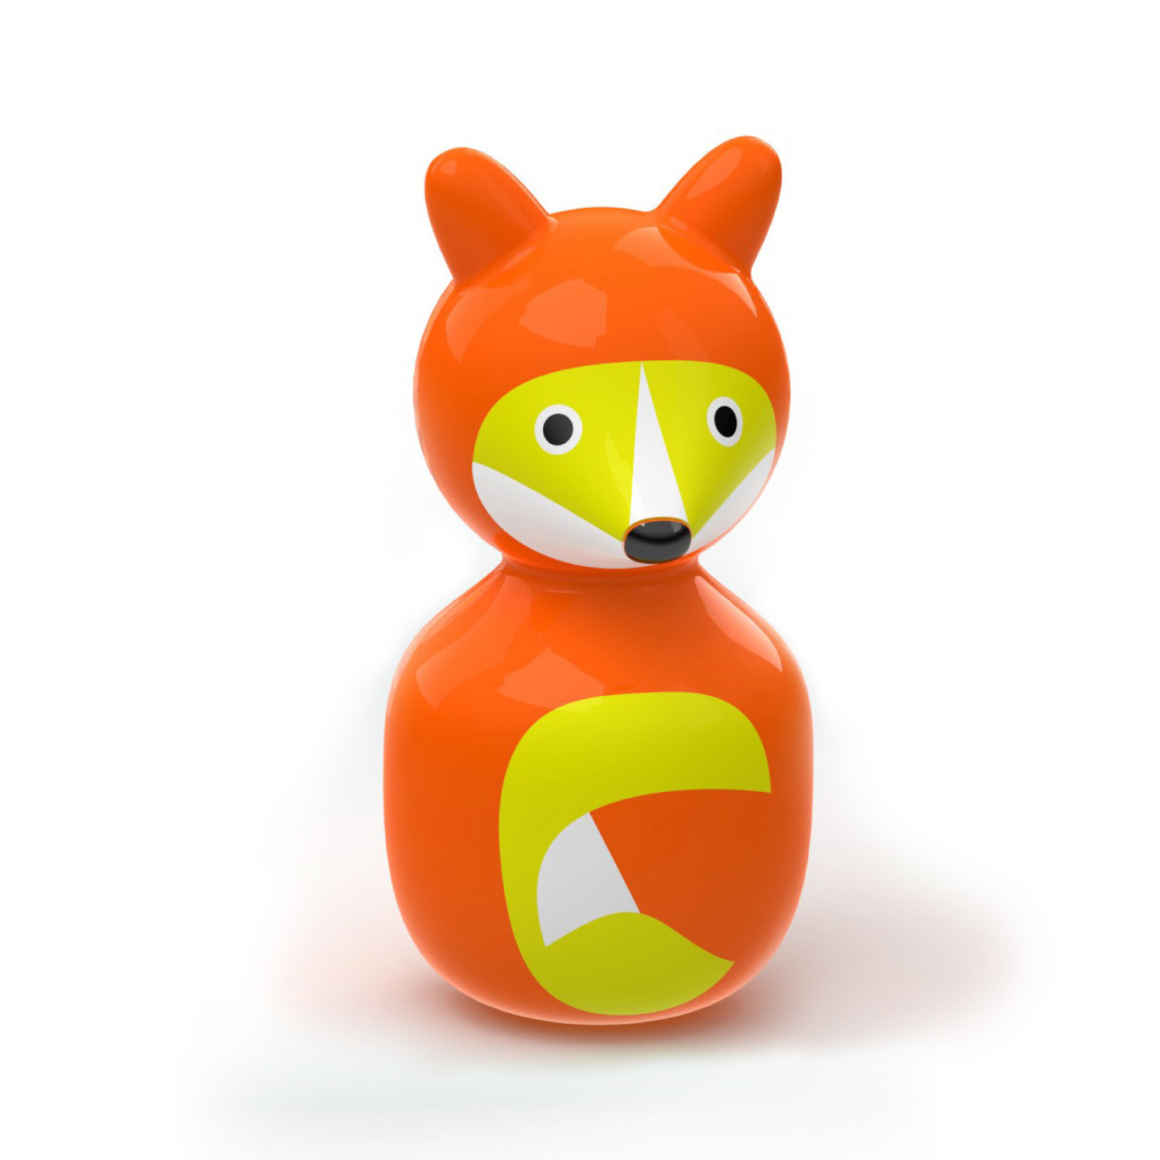
Wobble Fox
Toy Name
Wobble Fox
Manufacturer
Kid O
Age
6 months – 15 months
Parts
Wobble Fox Toy
Develop Skills
Fine Motor
Imagination
Social
Cognitive
How it Works
Dorong, tarik, atau genggamlah Wobble Fox lucu ini dan ia akan selalu kembali pada posisi semula.
-
Push, pull, or grasp this cute Wobble Fox and it will always stand back up.
How To Clean
Simply clean using a cloth that has been sprayed with non-toxic anti bacterial solution
Warning
Store in a dry place
Keep out of direct sunlight

